Slide 1
Terrible Triad Injuries Surgical Technique
.
Saurabh Aggarwal
Consultant Trauma, Elbow & Upper Limb Surgeon
Princess Royal University Hospital, London
Orthopaedic Principles 2022

Slide 2
Rotatory Fracture Dislocations of Elbow
Forces Imparted to elbow -
Axial load
Valgus or Varus movement
External or Internal rotation forces

Slide 3
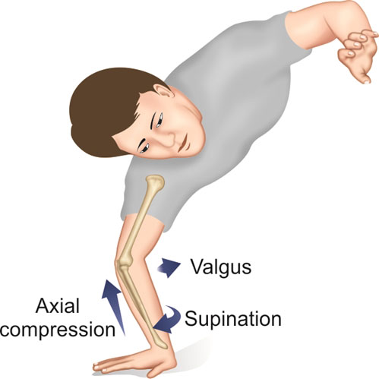
Patterns of injury -
Posterolateral pattern -
Valgus
External rotation
Bony & soft injuries
will tell us which
pattern of injury

Slide 4
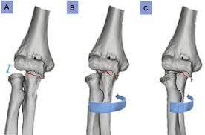
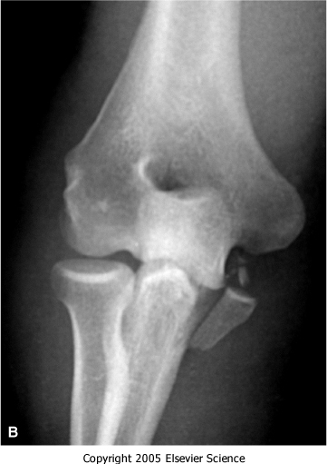
Patterns of injury -
Posteromedial pattern -
Varus
Internal rotation
Bony & soft injuries will tell
us which pattern of injury

Slide 5
Patterns of injury -
Posterolateral pattern (PLRI)-
Valgus
External rotation
Radial head fracture
Coronoid tip fracture
LCL rupture
Possible ant band of MCL rupture
Posteromedial pattern (PMRI)-
Varus
Internal rotation
Radial head intact
Anteromedial coronoid fracture
LCL rupture
Possible post band of MCL rupture

Slide 6
VARUS PMRI –
LCL FAILS UNDER TENSION AM FACET FRACTURE POST BAND MCL MAY INJURE RADIAL HEAD INTACT

Slide 7
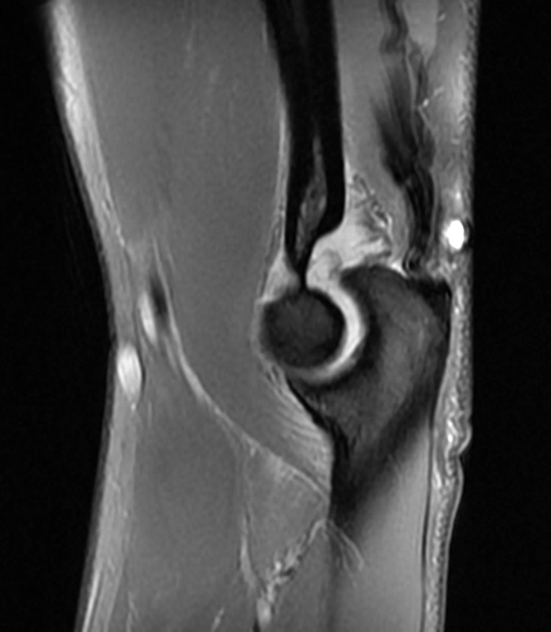
Consequences of missing a Varus PMRI

Slide 8
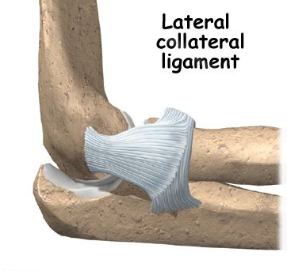
LCL
Hammock cradling radial head
Provides varus stability &
Ext rotation stability
Gets injured in both PLRI & PMRI

Slide 9
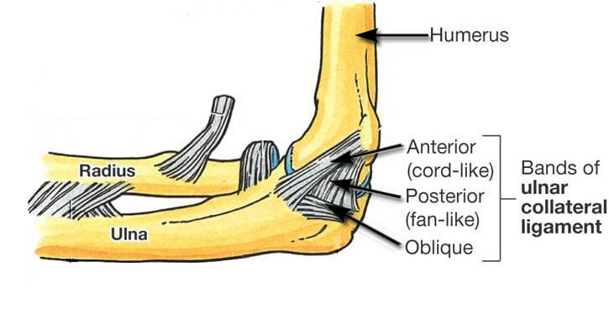
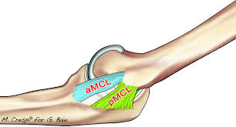
MCL
Provides valgus & internal rotation stability
Ant band may get injured in PLRI injuries
Post band may get injured in PMRI injuries

Slide 10
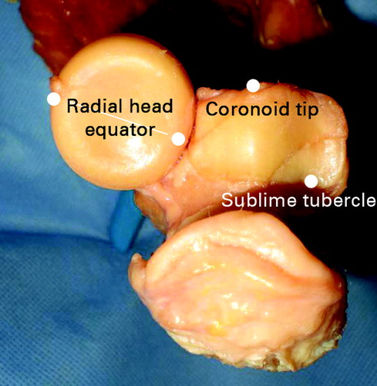
Role of Coronoid
Saggital plane stability
Coronal plane stability
Axial plane stability
Coronoid is the key to elbow
fracture dislocation

Slide 11
WHAT IS CORONOID ATTACHED TO ?
Monteggia Fracture Dislocation
Trans olecranon Fracture Dislocation
Transulnar Fracture Dislocation
Coronoid is the key to elbow fracture dislocation

Slide 12
CORONOID ATTACHED TO OLECRANON Monteggia Fracture Dislocation

Slide 13
CORONOID ATTACHED TO SHAFT Trans olecranon Fracture Dislocation

Slide 14
CORONOID IS A SEPARATE PIECE Transulnar Fracture Dislocation

Slide 15
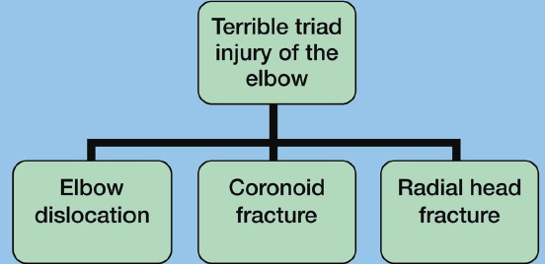
Terrible Triad Injury – Coronoid Tip Fracture
.
LCL
Possible Ant band MCL
Anterior capsular injury

Slide 16
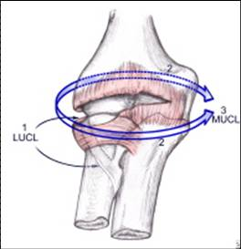
Mechanism of injury Posterolateral pattern
Mode of failure
Circle of Horii

Slide 17
PRINCIPLES OF FIXATION
Good Imaging. But expect the unexpected
Careful positioning
Universal posterior approach vs Dual approach
1st Fix coronoid tip fracture (anterior capsule avulsion). Do not reduce
2nd radial head – fix well or replace
Reduce dislocation
3rd Repair LUCL
Then Post sag test
If needed then MCL
If needed then Ex Fix / IJS

Slide 18
26 YOM, VALGUS TERRIBLE TRIAD INJURY
What Approach ?
What to address ?
Sequence of repair ?
.

Slide 19
Positioning Approach

Slide 20
1st repair coronoid tip fracture (capsule repair)
Use lateral approach
If inaccessible use medial
approach
Use –
suture lasso technique
retrograde screw fixation

Slide 21
Suture lasso fixation done

Slide 22
Suture lasso fixation done
video

Slide 23
2nd repair – Radial head fracture
Replace or fix
I use a porous coated acumed press fit modular radial head
Radial height
and
Size
important

Slide 24
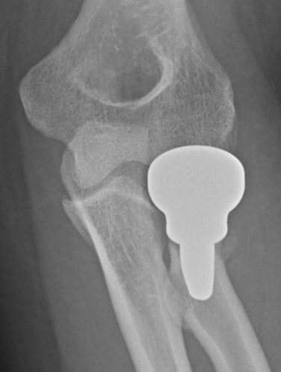
Overstuffing

Slide 25
3rd repair – Lateral collateral ligament

Slide 26
Posterior Sag Test –ve MCL left alone

Slide 27
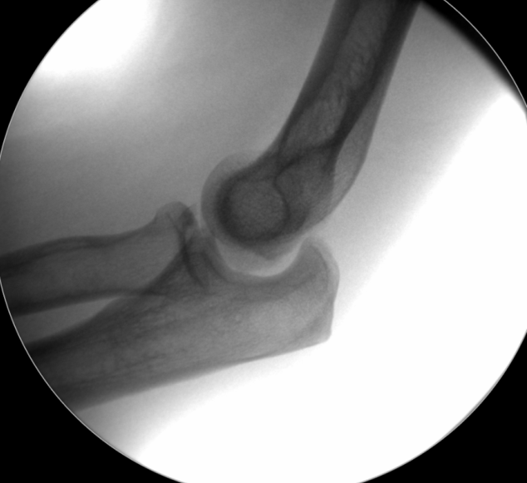
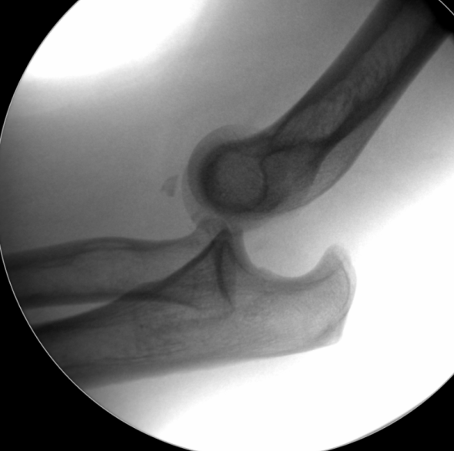
EUA – post sag at 60 degrees – unstable elbow

Slide 28
X rays 3 months post op

Slide 29
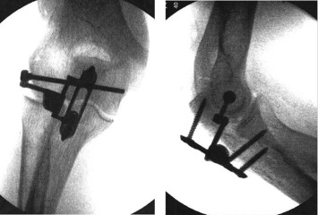
Ex Fix and IJS (Internal joint stabilizer)

Slide 30
Summary
Rotatory Fracture Dislocations of Elbow
Other Fracture Dislocations of Elbow
Defined Terrible Triad Injury
Surgical Technique ( tips & tricks )

Slide 31
Thank you

Slide 33
PLRI TEST

Slide 36
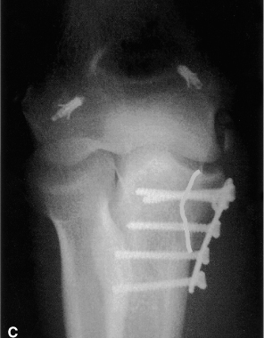
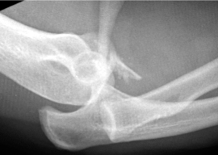
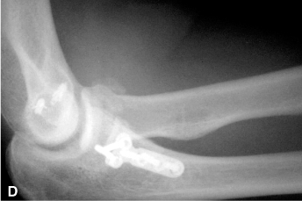
Coronoid is the key to elbow fracture dislocation
FRACTURE ANTER0-MEDIAL FACET
.
.
.

Slide 37
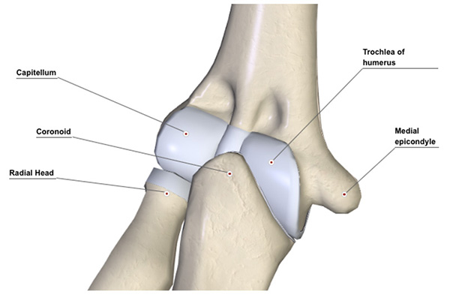
Role of Coronoid
Saggital plane stability
Coronal plane stability
Axial plane stability
Insert 3D VIDEOS / pictures from google

Slide 38
TRANS ULNAR # DISLOCATION WHAT IS CORONOID ATTACHED TO ?

Slide 39
TRANS ULNAR # DISLOCATION WHAT IS CORONOID ATTACHED TO ?

Slide 40
Trans ulnar fracture dislocation sequence of plating

Slide 42
VARUS PMRI –
LCL FAILS UNDER TENSION AM FACET FRACTURE POST BAND MCL MAY INJURE RADIAL HEAD INTACT

Slide 43
Consequences of missing a Varus PMRI

Slide 44
PMRI acute injury – m/m

